Slide 1
Financial Aid 101
Paying for College

Slide 2
Topics We Will Discuss Tonight
What is financial aid?
Cost of attendance (COA)
Expected family contribution (EFC)
Financial need
Types and sources of financial aid
FAFSA (Free Application for Federal Student Aid)
Special circumstances

Slide 3

What is Financial Aid?
Funds for students and families to help pay for college.

Slide 4

What is Financial Aid?

Slide 5




What is Cost of Attendance (COA)?
Direct costs+ Indirect costs= Cost of attendance
Varies widely from college to college

Slide 6
What is Expected Family Contribution (EFC)?
Amount family can reasonably be expected to contribute
Stays the same regardless of college (usually)
Two components
  Parent contribution
  Student contribution
Calculated using data from FAFSA

Slide 7
What is Financial Need?
Cost of Attendance
– Expected Family Contribution
= Financial Need

Slide 8
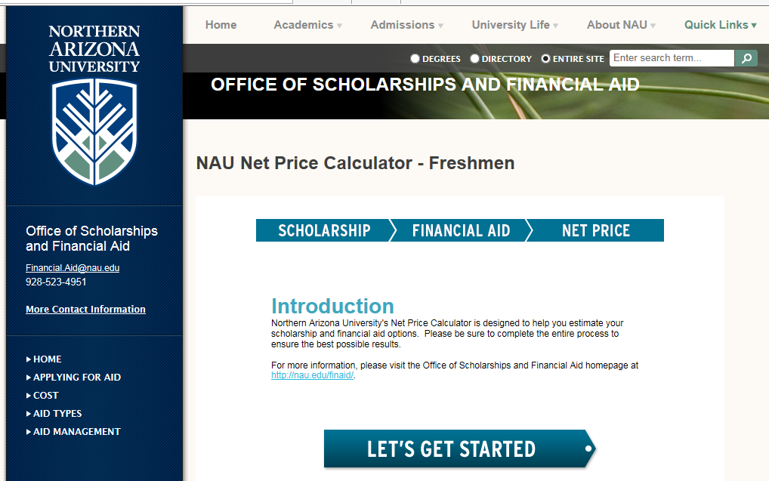
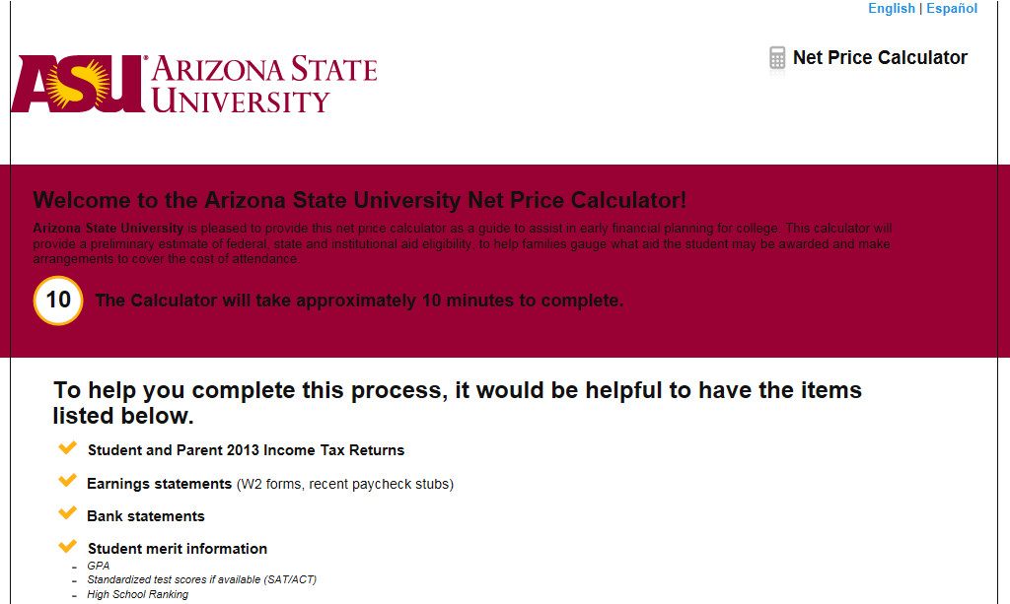
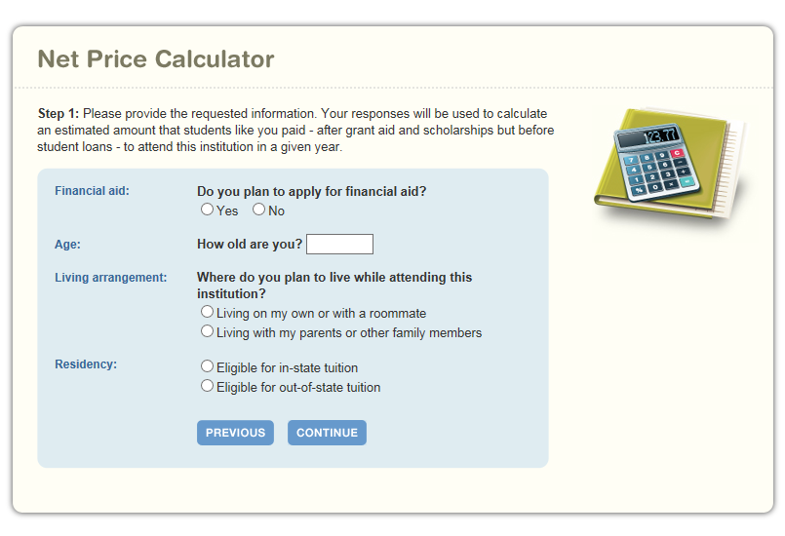

Net Price Calculator
Google school name + net price calculator

Slide 9
Types of Financial Aid
Scholarships
Grants
Loans
Employment
Gift Aid
Self-Help Aid

Slide 10
Gift Aid: Scholarships
Money that does not have to be paid back
Awarded on the basis of merit, skill, or unique characteristic
A lot of scholarship money is automatically awarded by schools
Use each school’s scholarship application.

Slide 11
Gift Aid: Scholarships
    Arizona Community Foundation
    www.azfoundation.org/scholarships
    Arizona Commission for Post Secondary Education
    azgrants.az.gov
    Flinn
    www.flinnscholars.org
    Pulliam
    ninascholars.asu.edu
    Dorrance
    www.dorrancescholarship.com
    College Depot
    www.phoenixpubliclibrary.org/collegedepot/Pages/Scholarships.aspx
    Fastweb
    www.fastweb.com
    Tuition Funding Sources
    www.tuitionfundingsources.com
    Check the Financial Aid / Scholarship website of the school you are applying at!

Slide 12
Gift Aid: Grants
Money that does not have to be paid back
Usually awarded on the basis of financial need

Slide 13
Gift Aid: Grants
Federal Pell Grant – Up to $5,845 next year
Federal SEOG (Supplemental Educational Opportunity) Grant – Varies
LEAP (Leveraging Educational Assistance Partnership)– Varies
TEACH (Teacher Education Assistance for College and Higher Education )- Varies, use caution
Grants from the College- Varies

Slide 14
Loans
Money students and parents borrow to help pay college expenses
Repayment usually begins after education is finished
Only borrow what you need
Consider loans as an investment in the future

Slide 15
Loans
Subsidized- Need based, no interest while in school
Unsubsidized- Not need based, interest accrues while you are in school
4.29% interest rate
PLUS- Loan for your parents
        6.84% interest rate

Slide 16
Loans
Subsidized- $3500
Unsubsidized- $2000
PLUS- $ Up to cost of attendance – other aid

Slide 17
Work-Study & Student Employment
Allows student to earn money to help pay educational costs
  A paycheck; or
  Nonmonetary compensation, such as room and board

Slide 18
Sources of Financial Aid
Federal government
States
Your college/university
Private sources
Civic organizations and churches
Employers

Slide 19
Federal Government
Largest source of financial aid
Aid awarded primarily for financial need
Must apply each year using the FAFSA

Slide 20
Federal Student Aid Programs
Federal Pell Grant
Iraq and Afghanistan Service Grant (IASG)
Teacher Education Assistance for College and Higher Education (TEACH) Grant
Federal Supplemental Educational Opportunity Grant (FSEOG)
Federal Perkins Loan
Federal Work-Study (FWS)
Subsidized and Unsubsidized Federal Direct Student Loans (Direct Loans)
PLUS Loans

Slide 21
Colleges and Universities
Award aid on the basis of both merit and need
Use information from the FAFSA and/or institutional applications
Deadlines and application requirements vary by institution
  Check with each college or university. Most want your file done March 1st or earlier.

Slide 22
Private Sources
Foundations, businesses, charitable organizations
Deadlines and application procedures vary widely
Begin researching private aid sources early

Slide 23
Civic Organizations and Churches
Research what is available in community
Organizations and churches
Application process usually occurs during spring of senior year
Small scholarships, but they can add up

Slide 24
Employers
Companies may have scholarships available to the children of employees
Companies may have educational benefits for their employees

Slide 25
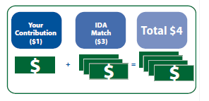
Individual Development Accounts
Student saves $1 and for every $1 a student saves, an outside grant agency contributes. $3-$8 depending on the program.
Check with your school as these are limited and there are specific criteria on who is eligible.

Slide 26
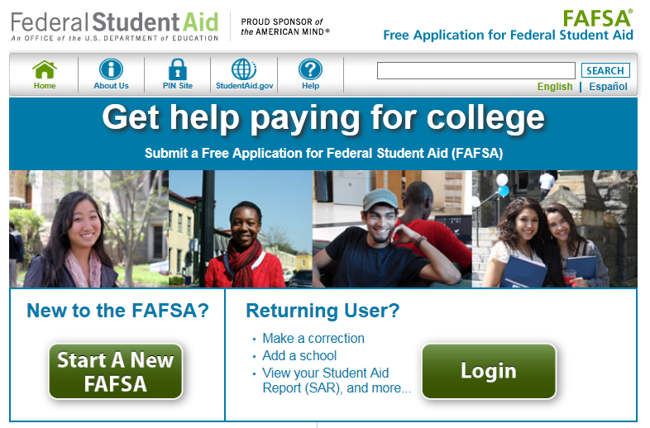
Free Application for Federal Student Aid (FAFSA)
Collects demographic and financial information about the student and family.
Available in English and Spanish
Free

Slide 27
FAFSA
Information used to calculate the expected family contribution (EFC)
  Amount of money a student and his or her family may reasonably be expected to contribute towards the cost of the student’s education for an academic year
Colleges use EFC to award financial aid

Slide 28
FAFSA
May be filed at any time during an academic year, but no earlier than the January 1st prior to the academic year for which the student requests aid
For the 2016–17 academic year, the FAFSA became available January 1, 2016. For the 2017-18 academic year it will be available October 1, 2016.
Priority dates at most colleges

Slide 29

FAFSA
Website: www.fafsa.gov
FAFSA on the Web Worksheet:
  Used as “pre-application” worksheet
  Questions follow order of FAFSA on the Web

Slide 30
FAFSA
Built-in edits to prevent costly errors
Skip-logic allows student and/or parent to skip unnecessary questions
Option to use Internal Revenue Service (IRS) Data Retrieval Tool (DRT) to import tax data

Slide 31
IRS Data Retrieval Tool
While completing FAFSA, applicant may submit real-time request to IRS for tax data
IRS will authenticate taxpayer’s identity
If match found, IRS sends real-time results to applicant in new browser window
Applicant chooses whether or not to transfer data to FAFSA

Slide 32

IRS Data Retrieval Tool (DRT)
Available early February 2016 for 2016–17
Participation is voluntary
Reduces documents requested by financial aid

Slide 33

IRS Data Retrieval Tool
Some will be unable to use IRS DRT
Examples include:
  Filed an amended tax return
  No Social Security Number (SSN) was entered
  Student or parent married but filed separately

Slide 34
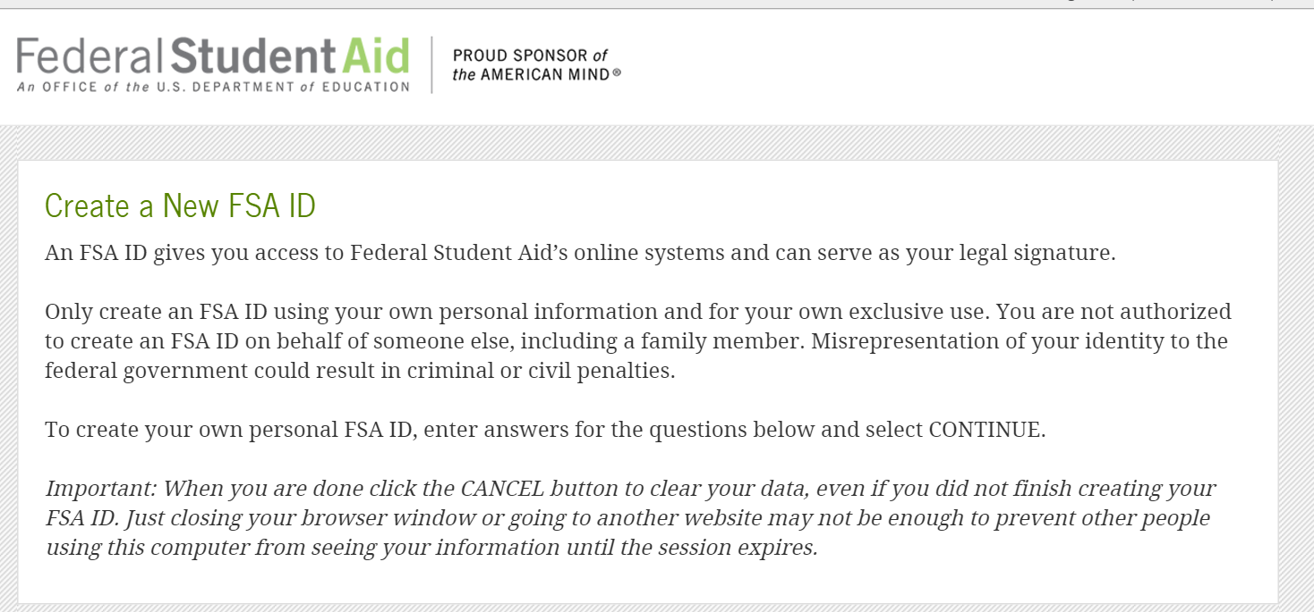
Federal Student Aid ID (FSAID)
Website: fsaid.ed.gov
Sign FAFSA electronically
One for the student
One for one of your parents

Slide 35
General Student Information
Social Security Number
Citizenship status
Marital status
Drug convictions
Selective Service registration
Level of parents’ school completion

Slide 36
Student Dependency Status
FAFSA asks questions to determine dependency status for federal student aid (not IRS) purposes:
If all “No” responses, student is dependent
If “Yes” to any question, student is independent

Slide 37
Student Dependency Questions
Will you be 24 or older by Dec. 31 of the school year for which you are applying for financial aid?
Will you be working toward a master’s or doctorate degree?
Are you married or separated but not divorced?
Do you have children who receive more than half of their support from you?
Do you have dependents (other than children or a spouse) who live with you and receive more than half of their support from you?
At any time since you turned age 13, were both of your parents deceased, were you in foster care, or were you a ward or dependent of the court?
Are you an emancipated minor or are you in a legal guardianship as determined by a court?
Are you an unaccompanied youth who is homeless or self-supporting and at risk of being homeless?
Are you currently serving on active duty in the U.S. armed forces for purposes other than training?
Are you a veteran of the U.S. armed forces?

Slide 38
Information About Parents of
Dependent Students
Income, taxes paid, and other financial information
Receipt of federal means-tested benefits
Assets
Untaxed income

Slide 39
Information About Student (and Spouse)
Tax, income, and other financial information
Receipt of federal means-tested benefits
Assets
Untaxed income

Slide 40
Additional Information
College and housing information- Colleges can see the other schools you have sent the FAFSA to.
FAFSA preparer information
Certification of Statement of Educational Purpose

Slide 41
Signatures
Required
  Student
  One parent (dependent students)
Format for submitting signatures
  Electronic using FSAID
  Signature page (print out and send in)

Slide 42
Frequent FAFSA Errors
Social Security Numbers
Divorced/remarried parental information
Income earned by parents/stepparents
Untaxed income
U.S. income taxes paid
Household size
Number of household members in college
Real estate and investment net worth

Slide 43

Lost in the middle of the FAFSA?

Slide 44
FAFSA Processing Results
CPS notifies student of FAFSA processing results by Email notification containing a direct link to student’s online SAR.
Student with FSAID may view SAR online at www.fafsa.gov

Slide 45
FAFSA Processing Results
FAFSA information is sent to colleges listed on FAFSA a few days after the FAFSA is submitted. Give schools a week or two to get the FAFSA loaded into their computer systems.
College reviews FAFSA
  May request additional documentation... And sometimes it is quite a lot.

Slide 46
Student Aid Report
Review data for accuracy and correct any errors
Update estimated tax information when actual figures become available

Slide 47

Making Corrections
If necessary, corrections to FAFSA data may be made by:
Using FAFSA on the Web (www.fafsa.gov)
or
Submitting documentation to financial aid office

Slide 48

Special Circumstances
Cannot be entered on FAFSA
Contact the financial aid office at each college
College will review and request additional information if necessary
Decisions are final and cannot be appealed to U.S. Department of Education
Not all colleges come to the same conclusion

Slide 49
Special Circumstances
Lost job/ reduced hours
Unusually high medical expenses not covered by insurance
Change in parent marital status
Death of a parent
Student cannot obtain parental information

Slide 50

Questions

